Slide 1

Advocacy Tools and Successful Practices to Protect Residents from Nursing Facility-Initiated Discharges
Ombudsman Learning Collaborative to Protect Residents Against Nursing Facility-Initiated Discharges
September 25, 2019

Slide 2

Training Objectives
Enhanced understanding of revised federal nursing facility regulations and guidance.
Learn new ways to apply the revised regulations and guidance to three common reasons for discharge.
Hear about how Ombudsman programs and legal services working together at the state and local level.
Highlight project state successes, challenges, and outcomes.
This Photo by Unknown Author is licensed under CC BY-SA-NC

Slide 3

Project Overview
Complaints about discharges have been the most common nursing home complaint received by Ombudsman programs for the last 7 years. In 2017, 10,610 of the 144,003 nursing home complaints were about discharges.
Supplemental grant from the Administration on Community Living (ACL) for the project.
7 project states (representing 6 of the 10 ACL regions)
  DC, Mississippi, Pennsylvania (ACL Regions III/IV)
  Ohio (ACL Region V/VII)
  Oklahoma, Louisiana (ACL Region VI)
  Nevada (ACL Region IX)
This Photo by Unknown Author is licensed under CC BY-SA-NC
Notes:
As you may know, complaints regarding nursing facility-initiated discharges have been the most common complaint received by Long-Term Care Ombudsman Programs (LTCOPs) for the last seven years. In 2017 about 7% of all NH complaints were related to discharges.
Despite regulatory protections against inappropriate facility-initiated discharges, they still occur, and Ombudsman programs have shared their need to have more advocacy tools, education, and collaboration to address this issue.
Thanks to a supplemental grant from the Administration for Community Living, we launched a project last October titled, Ombudsman Learning Collaborative to Protect Residents Against Nursing Facility-Initiated Discharges, to enhance the effectiveness of Ombudsman program advocacy related to this issue.
For this project, the Consumer Voice, through NORC, has provided in-depth technical assistance and training for the seven project states DC, LA, MS, NV, OK, OH, and PA. We held monthly TA calls with all project states, held one training webinar, and hosted three peer-to-peer learning roundtables (with the fourth and final roundtable scheduled during the CV conference in November). This webinar is part of the project and as Jamie will share later we also have a resource that will be shared with the entire network.
Attendees today include State Ombudsmen, representatives of the Office, legal assistance developers (LADs), and legal assistance providers. We are also working with the National Center on Law and Elder Rights (NCLER) with Justice in Aging for this project and you will hear from Eric Carlson later in this presentation.

Slide 4
Pre-test poll

Slide 5
Advocacy tools and strategies for common discharge reasons
Robyn Grant, Director, Public Policy and Advocacy, Consumer Voice

Slide 6

Regulatory Tools
Regulations: Requirements that facilities must follow in order to participate in the Medicare and /or Medicaid programs (Requirements of Participation)
Guidance: Also called Interpretive Guidelines or Interpretive Guidance, these interpret, explain and clarify the Requirements of Participation. Surveyors use the guidance to determine if a facility complies with federal requirements. The guidance is found in the State Operations Manual, Appendix PP - Guidance to Surveyors for Long Term Care Facilities (Rev. 11-22-17).

Slide 7
Regulatory Tools
Critical element pathways: The pathways help direct the surveyor’s inspection and identify points to observe, questions to ask, and records to review. There are critical element pathways for many, but not all the requirements.
Investigative Protocols, Procedures, Probes: There are several areas that do not have a pathway. If an area does not have a pathway, surveyors are instructed to use the guidelines, investigative protocols, procedures, and/or probes in Appendix PP, which also include observation, interview and record review probes.
Key Elements of Noncompliance: These are the main points for surveyors to focus on to determine if there is a deficiency.

Slide 8
https://theconsumervoice.org/uploads/files/issues/Revised_Interpretive_Guidelines_with_Clickable_TOC.pdf

Slide 9
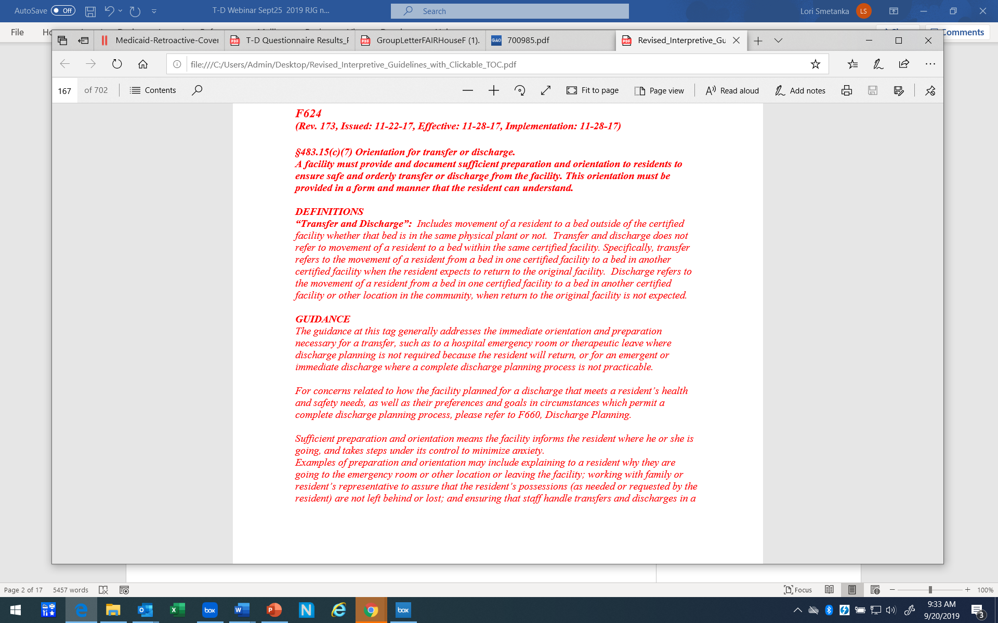
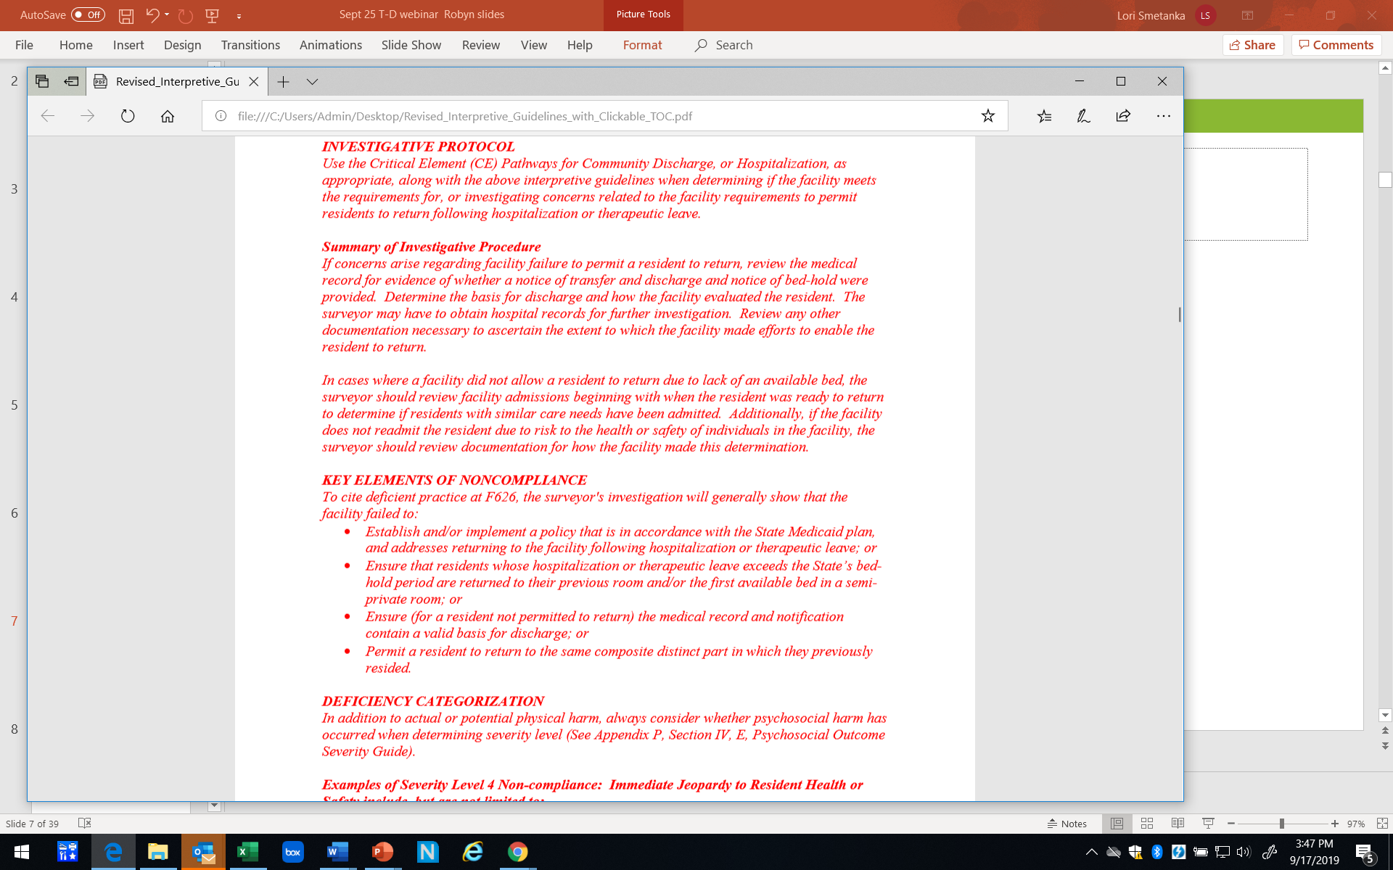

Slide 10
https://ltcombudsman.org/uploads/files/support/CMS-20067_Behavioral-Emotional.pdf

Slide 11
Links
Appendix PP
file:///C:/Users/Admin/Desktop/Revised_Interpretive_Guidelines_with_Clickable_TOC.pdf
Critical Element Pathways
https://www.cms.gov/Medicare/Provider-Enrollment-and-Certification/GuidanceforLawsAndRegulations/Nursing-Homes.html

Slide 12
Handout
https://ltcombudsman.org/uploads/files/support/Appendix_PP_-_Transfer-Discharge.pdf

Slide 13
Reason: Resident’s Welfare and Needs Cannot be Met in the Facility
Scenario:
  Mr. W has a traumatic brain injury and has difficulty thinking, understanding and concentrating. He is impulsive, restless, and verbally aggressive. Facility issued a 30-day notice stating they cannot meet his needs. Mr. W does not want to leave the nursing home and requests Ombudsman assistance.

Slide 14
Prevent eviction:
Encourage resident to file an appeal
Regulation: Facility cannot transfer/discharge a resident while the appeal is pending (except in certain situations)
  F622 483.15(c)(1)(ii) Handout: p. 156
Guidance: When a resident chooses to appeal his or her discharge from the facility, the facility may not discharge the resident while the appeal is pending.
  F622 Handout p. 159

Slide 15
Disclosure of Limitations
Regulation: The facility must disclose notice of special characteristics or service limitations prior to admission
  F620 483.15(a)(6) Handout: p. 148
Guidance: To enable potential residents and resident representatives to make informed decisions in choosing a facility for admission, facilities must inform residents and resident representatives and potential residents or representatives of any special characteristics or service limitations the facility may have prior to admission. For example … if a facility has limitations in the type of medical care it can provide, this information must be communicated prior to admission. For example, if the need for a specific type of care or service becomes necessary, knowledge of service limitations may make the need for transfer or discharge more predictable and understandable for the resident and/or his or her representative
  F620 Handout: p.151

Slide 16
Admission of only residents whose needs can be met
Guidance: Transfer/discharge regulations only permit transfer or discharge under certain limited conditions. This means that once admitted, for most residents (other than short-stay rehabilitation residents) the facility becomes the resident’s home. Facilities are required to determine their capacity and capability to care for the residents they admit. Therefore, facilities should not admit residents whose needs they cannot meet based on the Facility Assessment. (See F838, Facility Assessment).
  F622 Handout: p. 158

Slide 17
Documentation
Regulation: The resident’s attending physician must document that the resident’s needs cannot be met
  F622 483.15(c )(2)(ii)(A) Handout: p. 156
Regulation: Documentation in the medical record must include:
  Specific resident need(s) that cannot be met
  Facility attempts to meet the resident needs
  Service available at the receiving facility to meet the need(s)
  F622 483.15 (c )(2)(i)(B) Handout: 156

Slide 18
Ask: Did the facility do everything required to meet a resident’s needs?
Review regulations, guidance, investigative protocols, procedures, probes, critical element pathways
  If the answer is no:
    It is premature for the facility to say it can’t meet the resident's needs
      Which means the discharge is invalid

Slide 19
Care Planning
Components of Person-Centered Care Planning
1. Is the resident’s care plan person-centered?
Regulation: The facility must develop and implement a comprehensive person-centered care plan … to meet a resident’s medical, nursing, and mental and psychosocial needs that are identified in the comprehensive assessment.
F656 483.21(b) Appendix PP: p. 206
Person-centered care - means to focus on the resident as the locus of control and support the resident in making their own choices and having control over their daily lives.

Slide 20
Care Planning
Includes reflecting resident preference and choices?
Regulation: The right to reside and receive services in the facility with reasonable accommodation of resident needs and preferences
F558 483.10(e)(3) Appendix PP: p. 20
Regulation: Self-determination.
(1) The resident has a right to choose activities, schedules (including sleeping and waking times), health care and providers of health care services consistent with his or her interests, assessments, plan of care and other applicable provisions of this part.
(2) The resident has the right to make choices about aspects of his or her life in the facility that are significant to the resident.
(3) The resident has a right to interact with members of the community and participate in community activities both inside and outside the facility.
F561 483.10(f)(1)-(3) Appendix PP: p. 23

Slide 21
Care Planning
2. Does the care plan have specific and appropriate interventions?
Guidance: The comprehensive care plan must reflect interventions to enable each resident to meet his/her objectives. Interventions are the specific care and services that will be implemented.
F656 Appendix PP: p. 208
3. Is the care plan carried out?
Regulation: The facility must develop and implement a comprehensive person-centered care plan for each resident
  F656 483.21(b)(1) Appendix PP: p. 206
Regulation: Residents have the right to receive the services and/or items included in the plan of care
  F553 483.10(c )(2)(iv) Appendix PP: p. 14

Slide 22
Care Planning
4. Is the care plan carried out consistently?
Investigative Summary and Probes: Is there evidence that the care plan interventions were implemented consistently across all shifts?
  F656 Appendix PP: p. 210
5. Is the care plan evaluated and modified if it’s not working?
Regulation: The care plan must be reviewed and revised after each assessment, including both the comprehensive and quarterly review assessments.
  F657 483. 21(b)(2)(iii) Appendix PP: p.212
Guidance: The resident’s care plan must be reviewed after each assessment, as required by §483.20, except discharge assessments, and revised based on changing goals, preferences and needs of the resident and in response to current interventions.
  F657 Appendix PP: p. 214

Slide 23
Behavioral Health Services
Regulation: The facility must provide behavioral health services so each resident can reach his or her highest possible level of functioning and well-being
  F740 483.40 Appendix PP: p. 423
Regulation: The facility must provide a resident who displays or is diagnosed with mental disorder …with appropriate treatment and services to correct the assessed problem or to reach highest possible level of functioning and well-being
  F742 483.40(b)(1) Appendix PP: p.434

Slide 24
Behavioral Health Services
Investigative Protocol: Record Review
Review the resident’s care plan for interventions to address the assessed problem.
  How are mental and psychosocial adjustment difficulties, a history of trauma, and/or PTSD addressed in the care plan?
  Does it describe the programs and activities that have been implemented to assist the resident in reaching and maintaining the highest level of mental and psychosocial functioning?
  Is the care plan written in measurable language that allows assessment of its effectiveness?
Are the data to be collected to evaluate the effectiveness of the care plan identified?
Are the data collection done according to the care plan?
Does record review indicate that the care and services outlined in the care plan are effective in decreasing the resident’s expressions or indications of distress?
If the data collected indicate that expressions or indications of distress are unchanged in frequency or severity over two or more assessment periods, is the plan reassessed and intervention approaches revised to support the resident in attaining the highest practicable mental and psychosocial well-being?
  F742 Appendix PP: p. 438

Slide 25
Behavioral Health Services
Key Elements of Noncompliance: To cite deficient practice at F740, the surveyor’s investigation will generally show that the facility failed to:
  Identify, address, and/or obtain necessary services for the behavioral health care needs of residents;
  Develop and implement person-centered care plans that include and support the behavioral health care needs, identified in the comprehensive assessment;
  Develop individualized interventions related to the resident’s diagnosed conditions;
  Review and revise behavioral health care plans that have not been effective and/or when the resident has a change in condition;
  Learn the resident’s history and prior level of functioning in order to identify appropriate goals and interventions;
  Identify individual resident responses to stressors and utilize person-centered interventions developed by the IDT to support each resident; or • Achieve expected improvements or maintain the expected stable rate of decline based on the progression of the resident’s diagnosed condition.
    F740 Appendix PP: p. 425
Notes:
the key elements of noncompliance for F740 .
-Both of these tools emphasize the facility must develop a person centered care plan to address the behavioral health care needs, develop individualized interventions, implement those interventions, evaluate whether they are effective and they are not addressing the behavioral issue, reassess and revise the interventions.

Slide 26
Behavioral Health Services
Staff
Regulation:
There must be sufficient staff
Staff must have appropriate competencies and skills sets
Competencies and skills sets must include knowledge of and appropriate training and supervision to care for residents with mental and psychosocial disorders
  F741 483.40(a) & (a)(1) Appendix PP: p. 428

Slide 27
Reason: The Safety of Individuals in the Facility is Endangered Due to the Clinical or Behavioral Status of the Resident
Scenario:
Mrs. J has a diagnosis of Lewy Body Dementia and has hallucinations that cause her to become scared and combative. Recently Mrs. J became frightened in the dining room on several occasions. She then struck another resident in the dining room and was immediately transferred to the hospital. Mrs. J received treatment and was in the hospital for a few days. When she was ready to go back to the nursing home, the facility issued a notice of discharge. Mrs. J has asked for Ombudsman assistance.

Slide 28
This is a Facility-Initiated Discharge
Regulation: If the facility decides the resident can’t return, it must follow transfer/discharge requirements (e.g. notice)
F626 483.15(e)(1)(ii) Handout: p. 170
Guidance: In situations where the facility intends to discharge the resident, the facility must comply with Transfer and Discharge Requirements at 483.15(c )….
  F626 Handout: p.170

Slide 29
Permitting resident to return
Evaluation (can’t meet needs/health or safety)
Guidance: A facility may have concerns about permitting a resident to return to the facility after a hospital stay due to the resident’s clinical or behavioral condition at the time of transfer. The facility must not evaluate the resident based on their condition when originally transferred to the hospital. The medical record should show evidence that the facility made efforts to:
  Determine if the resident still required services and is eligible for Medicare or Medicaid
  Obtain an accurate status of the resident’s condition
  Find out what treatments, medications, and services were provided by the hospital, and determine whether the facility can provide them
  Work with the hospital to ensure the resident’s needs and condition are within the nursing home’s scope of care
  F626 Handout: p.173
Notes:
Argue – must evaluate and have evidence of that evaluation - if not – does not meet criteria for discharge – discharge is not permissible – resident must be permitted to return.

Slide 30
Permitting resident to return
Appeals
If the resident appeals discharge while in a hospital:
Guidance: Facilities must allow the resident to return pending their appeal, unless there is evidence that the facility cannot meet the resident’s needs, or the resident’s return would pose a danger to the health or safety of the resident or others in the facility.
  A facility’s determination to not permit a resident to return while an appeal of the resident’s discharge is pending must not be based on the resident’s condition when originally transferred to the hospital.
    F622 Handout: p. 159
Additional guidance: Handout p. 170, 173

Slide 31
https://www.cms.gov/medicare/provider-enrollment-and-certification/guidanceforlawsandregulations/nursing-homes.html

Slide 32
Behavioral Health Services
Dementia care
Regulation: The facility must ensure that—
  A resident who displays or is diagnosed with dementia, receives the appropriate treatment and services to attain or maintain his or her highest practicable physical, mental, and psychosocial well-being.
  F744 483.40(b)(3) Appendix PP: p. 445

Slide 33
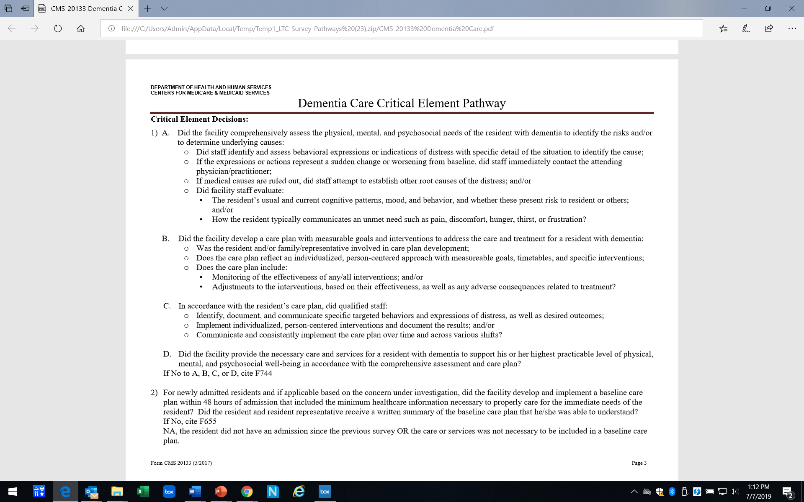
https://www.cms.gov/medicare/provider-enrollment-and-certification/guidanceforlawsandregulations/nursing-homes.html

Slide 34
Behavioral Health Services
Training
Regulation: Facilities must provide training to all staff on dementia management
  F943 483.95 (c)(3) Appendix PP: p.695

Slide 35
Reason: Resident has Failed to Pay After Reasonable and Appropriate Notice
Scenario
Mrs. S had been paying privately for her nursing home stay, but she has exhausted her financial resources. Her family helped her complete and submit a Medicaid application, but Mrs. S has not yet heard if her application has been approved. The facility has not been paid for 2 months and has issued a discharge notice. Mrs. S has asked the Ombudsman for help.

Slide 36
Nonpayment has not occurred
Regulation: … Nonpayment applies if the resident does not submit the necessary paperwork for third party payment or after the third party, including Medicare or Medicaid, denies the claim and the resident refuses to pay for his or her stay.
F622 483.15(c)(1)(i)(E) Appendix PP: p.157
Guidance: NOTE: A resident cannot be discharged for nonpayment while their Medicaid eligibility is pending (See F622, Transfer and Discharge Requirements).
  F620 §483.15(a)(4)(i) and (ii) Appendix PP: p.152

Slide 37
Nonpayment has not occurred
Guidance: Additionally, if a resident’s initial Medicaid application is denied but appealed, the resident is not considered to be in nonpayment status. Thus, an appeal suspends a finding of nonpayment.
F622 Appendix PP: p. 159

Slide 38
Facility responsibility
Guidance: It is the responsibility of the facility to notify the resident of their change in payment status, and the facility should ensure the resident has the necessary assistance to submit any third party paperwork.
F622 Appendix PP: p. 159

Slide 39

Procedural arguments
Is the nursing home following the required process?
Are there any:
  T’s that aren’t crossed?
  I’s that aren’t dotted?

Slide 40
Notice
Contents of the notice 483.15(c)(5)
Does it include the reason for discharge and is that reason an allowable reason for discharge pursuant to state & federal law?
Is there an effective date for discharge?
Does the notice list a specific place to which the resident will be discharged?
Does it tell residents they have the right to appeal?
Does the appeal information contain all the required information:
  The name, address (mailing and email), and telephone number of the entity which receives such requests;
  Information on how to obtain an appeal form and assistance in completing the form and submitting the appeal hearing request;
Does it include contact info for SLTCO and Protection & Advocacy?
AND: Is all the information accurate/correct?

Slide 41
Notice
Who is notified 483.15(c)(3)
The resident
The resident’s representative
The LTCOP
Timing of the notice 483.15(c)(4)
Was the notice given at least 30 days before the proposed discharge?
(except under certain circumstances)
Changes in the notice 483.15(c)(6) & Guidance p. 166
Has anything significant changed since the original notice was issued. e.g. location of discharge
If so, the facility must issue a new notice and restart the 30-day clock

Slide 42
Documentation
Regulation: The resident’s record must include:
  Basis for transfer/discharge
  When discharge allegedly for resident’s welfare, the specific resident needs that cannot be met, how facility attempted to meet needs, and how receiving facility will meet needs.
  Documentation by resident’s physician/a physician
  F622 483.15(c )(2)(i)&(ii) Handout: p. 156

Slide 43
Documentation
Regulation: Discharge planning
  Documentation about returning to the community
    F660 483.21(c)(1)(vii) Appendix PP: p. 219
  A discharge plan, discharge summary
    F660, F661 483.21(c )(1)(i) & (c)(2) Appendix PP: p. 219, p. 224
  Post discharge plan
    F661 483.21((c )(2)(iv) Appendix PP: p. 225

Slide 44
Bottom Line
If anything in the notice is missing or inconsistent with federal requirements:
Advocate for the facility to reissue the notice and restart 30-day clock or throw out the notice on procedural grounds.
At appeal: argue to have the proposed discharge dismissed on procedural grounds

Slide 45



The National Consumer Voice for Quality Long-Term Care
www.theconsumervoice.org
Connect with us:
National Consumer Voice for Quality Long-Term Care
@ConsumerVoices

Slide 46
Legal Services and ombudsman programs – working together
Eric Carlson, Directing Attorney, Justice in Aging

Slide 47
Legal Services and Ombudsman,
Working Together
Eric Carlson
September 25, 2019

Slide 49
Difficulty for Legal Services in Reaching Potential Clients
Physical limitations.
Dementia.
Unfamiliarity with laws.
Deference to/intimidation by facility.
Plus all other reasons potential clients don’t get to legal services offices.

Slide 50
Possible Strategies
Contact Ombudsman Program.
  Ombudsman meets residents face-to-face.
    Willingness to work with legal services will vary, depending on the program.
Publicize relevant law.
  Presentations.
  Guides.
Publicize legal services program and its interest in these issues.

Slide 51
Unfamiliar Law
Resources include (apologies for self-promotion)
  25 Nursing Home Problems, and How to Resolve Them (Justice in Aging)
  Long-Term Care Advocacy (LEXIS Publishing)
  Resources from National Consumer Voice for Quality Long-Term Care
  Resources (particularly re: Medicare coverage) from Center for Medicare Advocacy

Slide 52
Sometimes Legal Services and Ombudsman Join Forces
Statewide programs
  Michigan Elder Justice Initiative
  Vermont Legal Aid, Inc.

Slide 53
Local Cooperation Between Ombudsman & Legal Services
E.g., Western New York.
  People Inc. (ombudsman program) and Center for Elder Law & Justice.
    Thanks to Lindsay Heckler of CELJ for info.
  Role of “legal liaison”
    Trainings.
    In-house legal support.
    Training for facilities and community.
    Legislative and administrative advocacy.

Slide 54
Common Legal Services Issues
Transfer/discharge; eviction.
Return from hospital.
Medicare coverage denials.
Medicaid eligibility issues and coverage denials.
Defending collection actions.
Decision-making issues.

Slide 55
Litigation to Prevent Residents from Being Dumped in Hospitals

Slide 56
Only Six Reasons to Evict
Nursing Facility Resident
Nonpayment.
Endangering others’ safety.
Endangering others’ health.
Needing higher level of care.
Not needing nursing facility care.
Nursing facility closing.
Resident has right to an administrative hearing.

Slide 57
Returning to Nursing Facility
After Hospitalization
Bed hold under state law.
  Paid out-of-pocket or through Medicaid.
Beyond bed hold, right to return under federal law to next available bed if returning under Medicaid or Medicare payment.

Slide 58
Falsehood: “You Can’t Return Because We Can’t Meet Your Needs.”
Under federal regs and guidance, facility must allow resident to return pending eviction hearing.
But some facilities nonetheless refuse to let residents return.
Resident may have difficulty getting prompt action from survey and certification agency.

Slide 59
Litigation Can Seek Prompt Return
Potential causes of action:
  Consumer law violations
  Breach of admission agreement
  Breach of Medicaid provider agreement, with resident as third-party beneficiary
  Tort claims, e.g., infliction of emotional distress
Request for immediate relief; i.e., temporary restraining order.
Judge likely will recognize unfairness of being “locked out” without due process.

Slide 60
Thank You
Eric Carlson
  ecarlson@justiceinaging.org
To receive Justice in Aging alerts, text 51555 with the message “4justice”

Slide 61
Project highlights
Jamie Freschi, NORC Consultant

Slide 62

The Learning Collaborative
This Photo by Unknown Author is licensed under CC BY-NC

Slide 63

Project Challenges

Slide 64
Project Challenges
Tracking transfer and discharge information
  Managing the notices
  What information to track
  Who is responsible for tracking
  What is to be gained from tracking
  Current documentation systems
  Lack of understanding on the part of the facilities about the specific requirements related to notifying the Ombudsman
Notes:
States noted a significant amount of information coming in from facilities – some information was required to be sent, but some states reported getting information on resident-initiated discharges and as well. While a large amount of notices and transfer logs were coming into the state offices, the states quickly realized that not all facilities were sending transfer and discharge notices to the ombudsman program.
Current documentation systems are not set up to easily track the type of information some states wanted to track, for instance consultations with T/D as a topic; so they developed another means to track the information.

Slide 65
Project Challenges
Individual Advocacy
  Residents that cannot communicate consent and/or provide direction
  Residents not receiving proper notice
  Residents not allowed to return to the facility after a hospitalization
  “Behaviors” as a reason for discharge
Systemic Advocacy
  Outdated or no standardized forms or confusing letters for transfer and discharge notices, and requests for a hearing
  Lack of significant penalties for not complying with regulations
  An overall lack of knowledge of the significant impact discharges have on residents
Notes:
1. Resident who can’t communicate consent often are unable to obtain legal services, and residents with no representatives and who cannot direct, often have no voice to request a hearing or to be represented in a hearing
2. We are still finding that some residents are receiving no written notice or only given a few days to discharge.
3. Residents are still being sent to the hospital and not accepted back to the facility. While you heard earlier in this presentation some tips and tools to combat this concern, it remains a problem that is potentially very damaging to residents and extremely time-consuming on the part of the Ombudsman
4. “Behaviors” as a reason for discharge has been a challenge for several reasons. This seems to be a catch-all whether the facility uses the official reason of it cannot meet the needs of the resident or the resident is a danger to others. Ombudsmen are seeing discharges for not following the smoking policy or a behavior contract, or for residents with dementia who are “combative”. A significant amount of time goes into investigating “behaviors” in preparation for a hearing.
Systemic
1. States that do not have standardized notices, or outdated standardized forms, express that residents, family members, hospital staff and ombudsman are often confused about what the notice means – is it an emergency transfer or is this a discharge. It is very confusing.
2. Ombudsman report that facilities will “take the tag” because there is not enough of a deterrent to follow the regulations.

Slide 66

Project Challenges
Collaboration
  State Agencies
    State Unit on Aging
    State survey agency
Notes:
Some states struggled with collaborating with their own state unit on aging and several states indicated that working with the state survey agency was a challenge, particularly getting the survey agency to understand that the transfer and discharge identified challenges are more than just a paperwork issue and that improper or illegal discharges have a huge impact on residents’ well-being.

Slide 67
Project Challenges
Legal/Administrative Hearings
  Hearings held via phone
  No clear process
  Lack of training on the Ombudsman program’s role in a hearing
  Lack of access to legal services
  Some attorneys and administrative law judges lack a solid understanding of federal requirements and residents’ rights
Notes:
Hearings not held in person are often not conducive to residents and give an unfair advantage to facilities.

Slide 68

Project Successes

Slide 69
Project Successes
Tracking transfer and discharge information
  Examples of information tracked
    Reason for discharge
    Location of discharge
    Facility and/or corporation trends
    Required information
    Request ombudsman assistance
  Analysis of data
    Shared with state agencies
    Shared with program staff
  Improvements made
    Ombudsman training
    Facility in-service training
Notes:
Project states came up with individual processes to track and analyze data coming in from the transfer logs and discharge notices. As the project advanced, states determined what new information they wanted to track and analyze. For example, OH found they have a 54.2% prevalence rate and of that percentage, 52.69% of cases are resolved prior to a hearing.
Trends were identified and shared with state agencies and program staff. In some project states, the sharing of data opened the door for a stronger collaboration between the ombudsman program and the state agencies.
The information gained was also used to improve Ombudsman training, determine in-service training to facility staff.

Slide 70
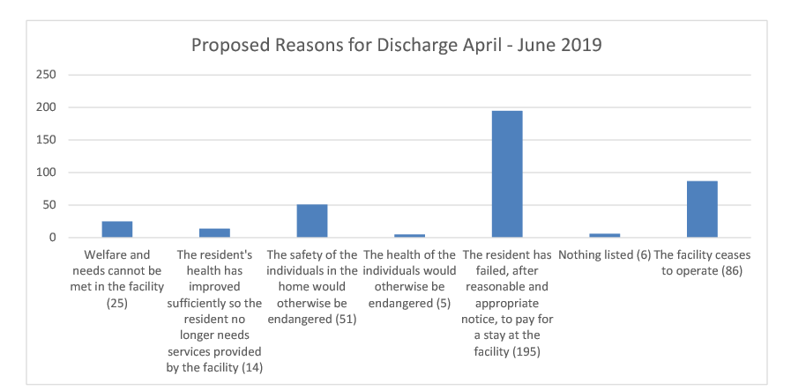
Tracking Example: Ohio

Slide 71

Project Successes
Advocacy
  Systemic Advocacy
  Individual Advocacy
Notes:
1. OK’s T/D pamphlet for residents when they are issued a notice
2. NV’s bill that was passed requiring all facility types to submit discharge notices to the State Ombudsman.
3. DC’s Annual Review identifies trends in notice deficiencies and shares the information with all ltc facilities, the licensing and surveying agency to mitigate future violations of federal and state laws. Because of the report, the SLTCOP Office had a facility reach out to the Office to host a district-wide training for all facilities on transfers and discharges.

Slide 72
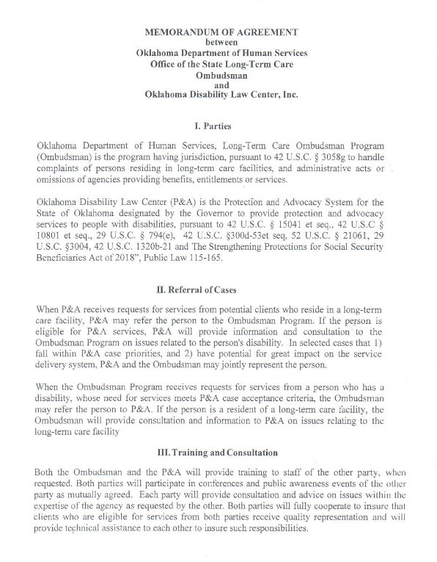
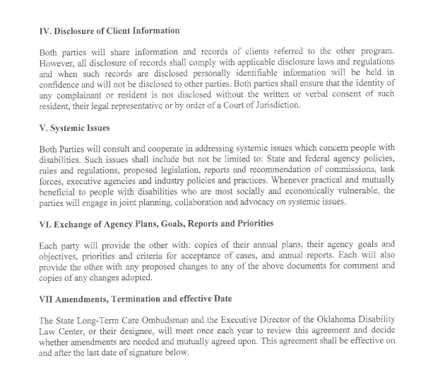
Project Successes
Collaboration
  Referrals
  Training
  NH associations
  State agencies
  MOUs
Notes:
Referrals to Legal Services; Reciprocal training with Legal Services; collaboration with NH associations on the transfer/discharge forms, MOUs with legal services and LADs

Slide 73

Project Successes
Legal/Administrative Hearings
Notes:
In one state, the Medicaid Agency has agreed to hear appeals on discharge cases. Prior to the Project, residents were not afforded due process on discharges.

Slide 74

Conclusions

Slide 75
Goals and Outcomes
Project States’ Goals | Outcomes
Manage discharge notices and learn strategies to collaborate with the state licensing agency. | Developed a process and a tracking tool for incoming transfer and discharge notices. Utilized tracked data to explain the significance of transfer and discharge concerns to successfully collaborate with state licensing agency, including a memo going out to facilities stressing the regulatory requirements.
Develop methods to increase effectiveness in program advocacy and complaint resolution. | Utilized a team approach with the ombudsman, the staff attorney, and the licensing agency to address one systemic discharge that violated residents’ rights. In the process of developing a “Model Discharge” document.
Collaborate with state agencies to develop a fair hearing appeal process and develop uniformity with ombudsman advocacy throughout the state. | Successfully advocated for a fair hearing process and now residents are afforded due process. Developed a new procedure for ombudsmen to take a more proactive approach to facility-initiated discharges.
Notes:
At the beginning of the project, states were asked to state their project goals. We have included most of the goals and the outcomes of the goals in the next few slides.
The Model Discharge document will be on our resource page once it is finalized. The Model Discharge Document explains facility requirements for transfers and discharges to ensure safe and orderly transfers and discharges and to protect residents’ health, safety, welfare and rights with a focus on residents’ needs and preferences. (per statute)

Slide 76
Goals and Outcomes
Project States’ Goals | Outcomes
Develop and promote education, training and assistance for Ombudsman, cross train with legal services, and track discharge notices. | Brought in a subject matter expert to conduct a state-wide training for ombudsmen and legal services on administrative hearings and is now tracking notices.
Improve communication with the state survey agency and providers on requirements for provisions of notice of discharge. Develop advocacy strategies to challenge complex discharge cases. Develop a data collection system. | Developed a data collection system and provided statistical analysis from data system to the state survey agency and the regional surveying agencies to point out concerns surrounding transfer and discharges. The continued sharing of data and the explanations of the meaning behind the data has improved communication with the state survey agency greatly. Brought in a subject matter expert to a state-wide training to address strategies when working with complex discharge cases.

Slide 77
Goals and Outcomes
Project States’ Goals | Outcomes
Avert unnecessary discharges and solidify continuity of care. | Conducted training for ombudsmen about averting discharges and 100 out of 140 of all discharge cases were averted as of the end of July for FY19. Residents were allowed to remain in their facility, solidifying continuity of care.
Ensure approach and advocacy towards discharge is the most effective and identify & approach trends and problems related to discharge. | Achieved an 82.3% resolution rate among discharge complaints within the first three quarters of CY19. Increased frequency of resident contact. In the first 3 quarters of CY19, ombudsman contacted 56% of residents who received notice. Of that 56%, ombudsmen opened cases on 54%. State Office reviews all hearing decision reports to develop guidance for ombudsman representatives for hearing preparation. Identified several common practices by facilities and corporate trends.
Notes:
Common trends: Homes pursue a quick and unsafe discharge, when a resident receives an adverse PASRR decision or denial.
“Hospital dumping” and using notices as a means of collecting payment
Most common reason: Failure to pay after reasonable and appropriate notice.
Most common proposed location: Another nursing facility.

Slide 78
Questions?

Slide 79
Post-test poll

Slide 80
resources

Slide 81
Project Resources
Webinars
  https://ltcombudsman.org/issues/transfer-discharge#norc
Project States’ Resources
  Transfer and discharge tracking forms
  Letters to facilities
  Annual and quarterly reports
Resource Guide
  Advocacy considerations
  Advocacy tools
  Advocacy tips

Slide 82
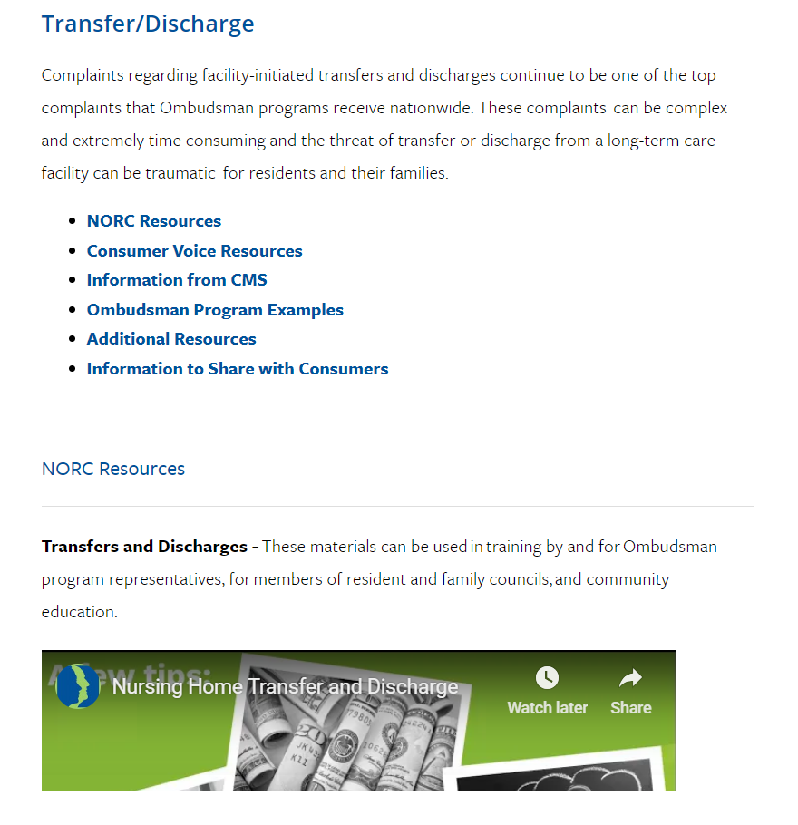
Transfer/Discharge Issue Page https://ltcombudsman.org/issues/transfer-discharge

Slide 83
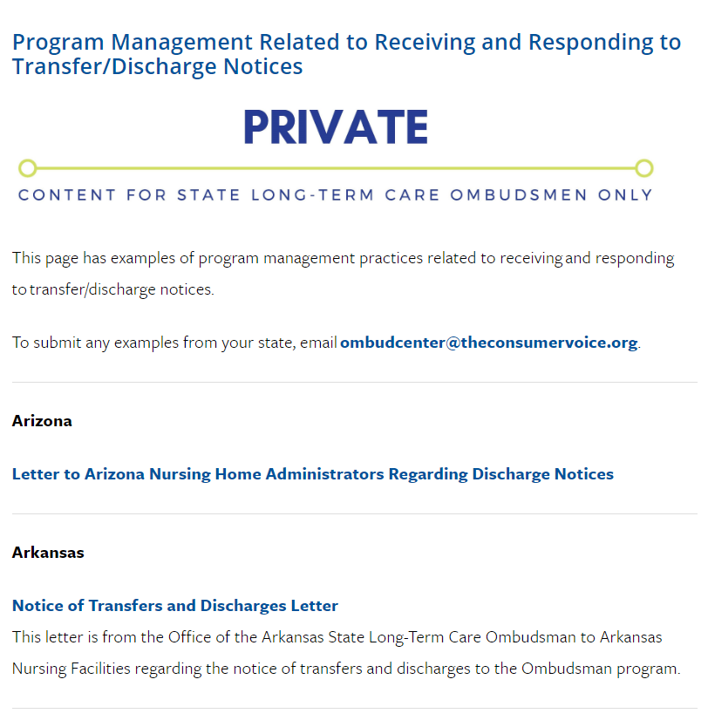
Program Management Regarding Nursing Facility Transfer/Discharge Notices https://ltcombudsman.org/state_home/state_support/discharge-notices

Slide 84
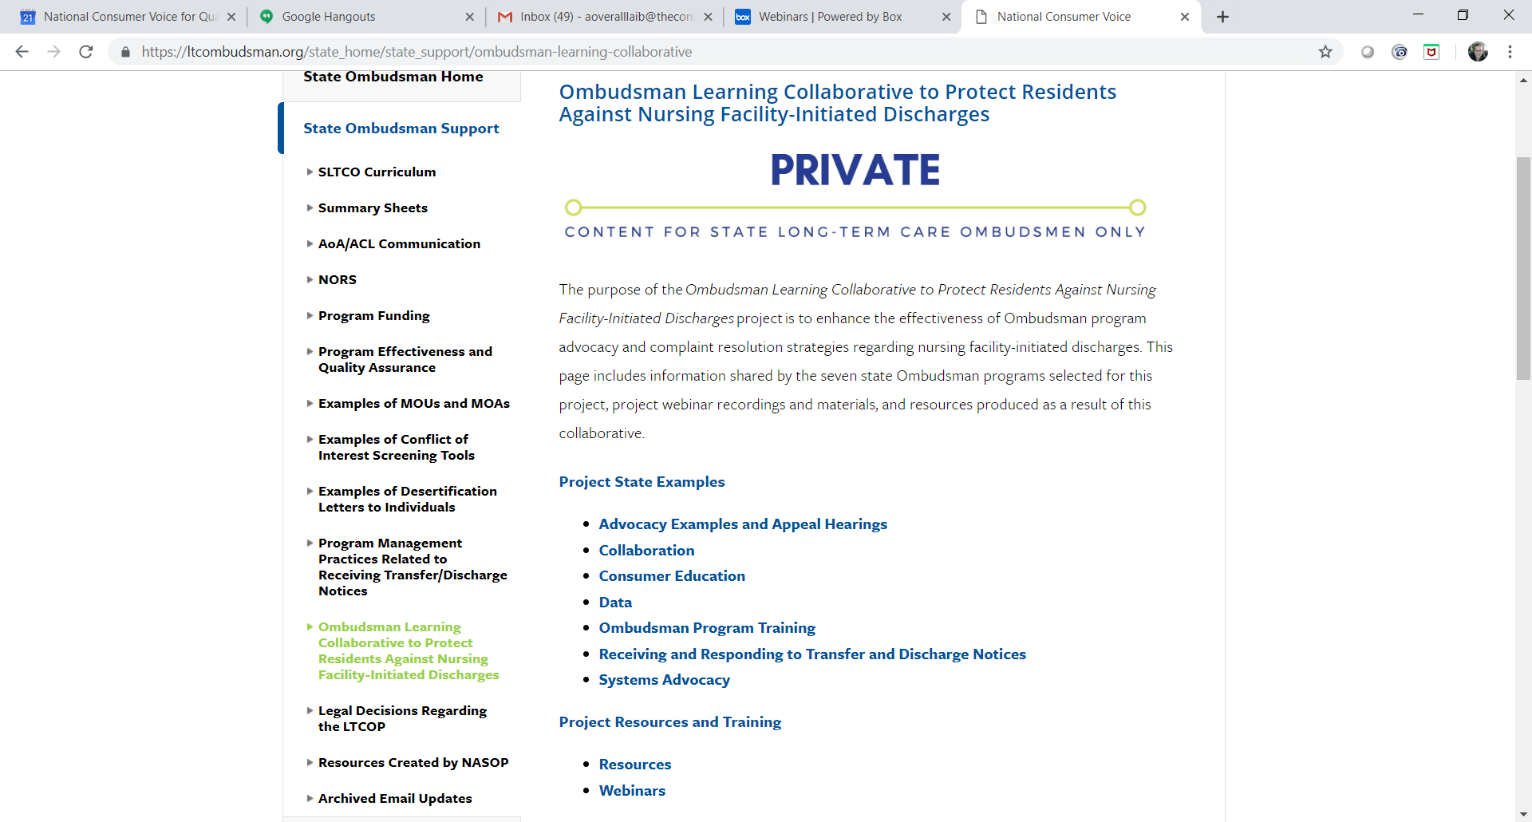
Ombudsman Learning Collaborative Landing Page https://ltcombudsman.org/state_home/state_support/ombudsman-learning-collaborative

Slide 85
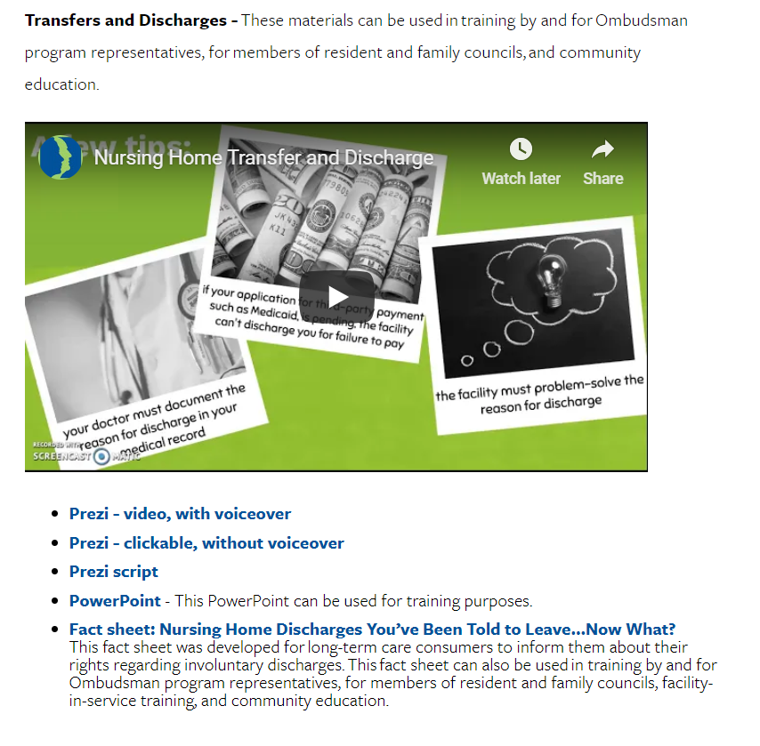
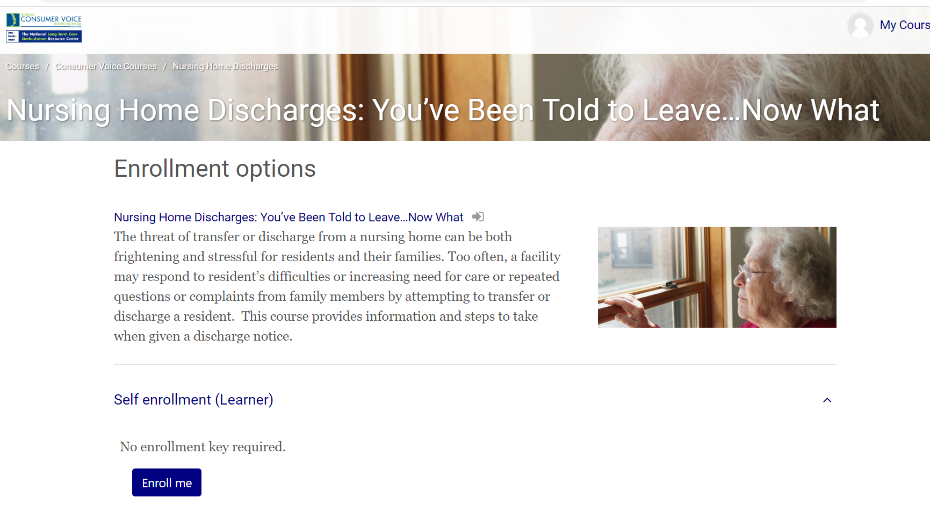
Training and Consumer Education Materials
https://ltcombudsman.org/issues/transfer-discharge#norc
https://consumervoice.mrooms.net/

Slide 86
Contact Information
Eric Carlson ecarlson@justiceinaging.org
Amity Overall-Laib aoveralllaib@theconsumervoice.org
Robyn Grant rgrant@theconsumervoice.org
Jamie Freschi jfreschi@fsconsultinghelps.com.

Slide 87



Connect with us:
www.ltcombudsman.org
The National LTC Ombudsman Resource Center
@LTCombudcenter
Get our app! Search for "LTC Ombudsman Resource Center" in the Apple Store or Google Play
This project was supported, in part, by grant number 90OMRC0001-01-00, from the U.S. Administration for Community Living, Department of Health and Human Services, Washington, D.C. 20201. Grantees undertaking projects under government sponsorship are encouraged to express freely their findings and conclusions. Points of view or opinions do not, therefore, necessarily represent official Administration for Community Living policy.
Notes:
Please complete the brief evaluation.

