Slide 1



Defending Topic Authority with Web Accessibility

Slide 2




Welcome
Post your questions
in the chat or
Q&A section.
Questions will be answered at the end
of the presentation.
This webinar will
be recorded and sent
to all registrants.
All attendees have
been muted.

Slide 3


Today's discussion moderated by
Ilyssa Russ​
Product Marketing Manager, Accessibility at Siteimprove

Slide 4
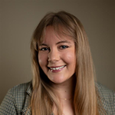

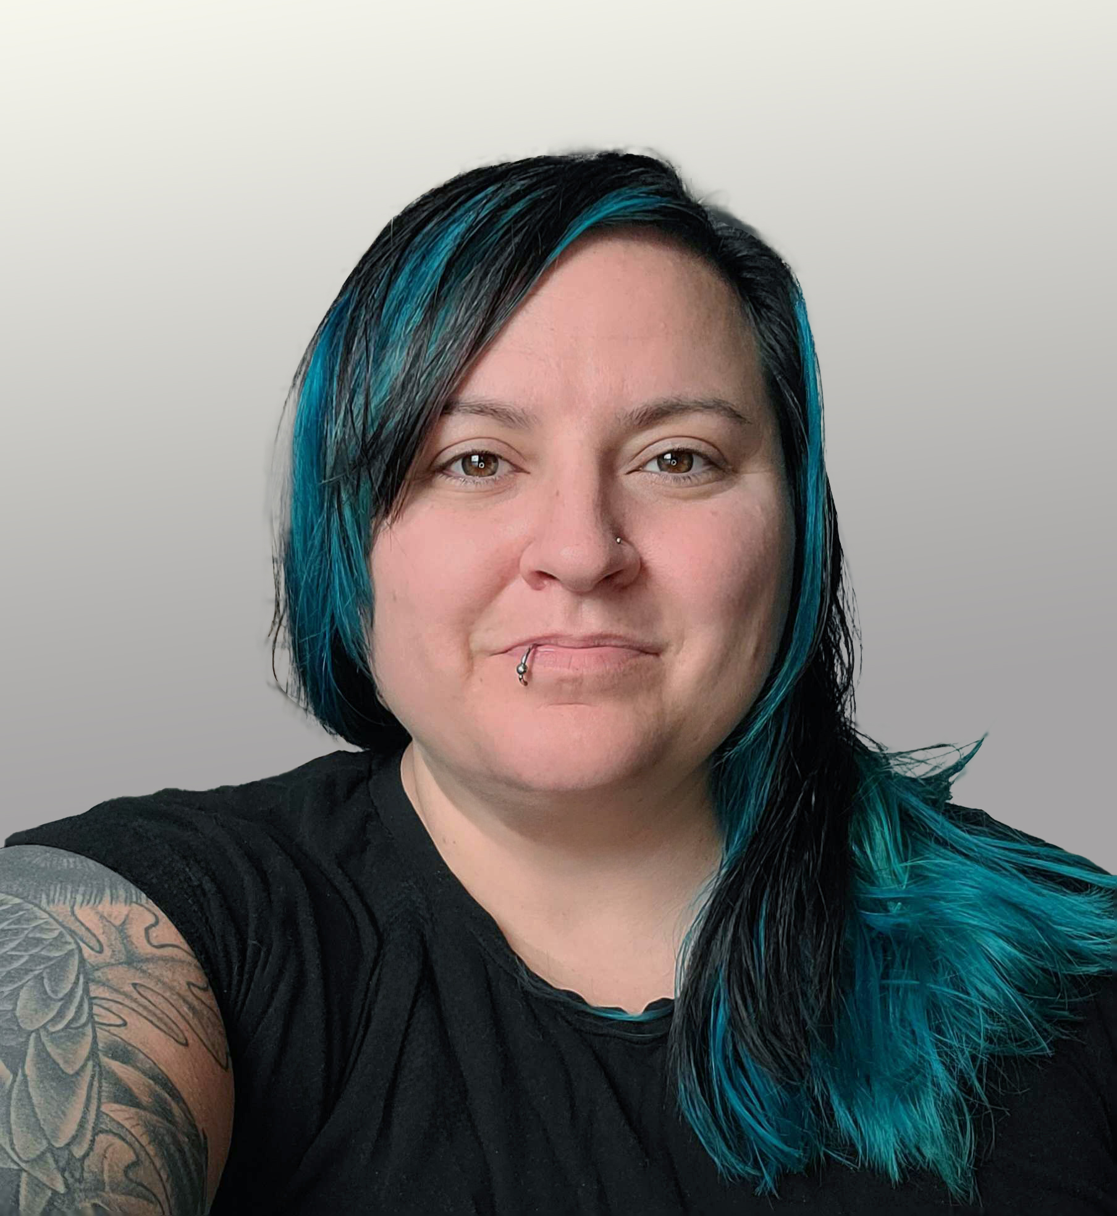
Introducing...
Emily Kumar
Diane Kulseth
Christina Adams, CPWA
Search Strategist at Indiana University
Manager, Digital Marketing Consulting at Siteimprove
Senior Manager of Digital Accessibility at Siteimprove
Notes:
Emily Kumar, Search Strategist at Indiana University
Emily Kumar is a Search Strategist at Indiana University, where she works to expand SEO and AI optimization knowledge and adoption across IU's web portfolio. She has been leveraging Siteimprove’s Marketing and SEO Enterprise tools to better connect search strategy and user experience with the university’s broader brand and marketing goals.
Diane Kulseth, Manager for Digital Marketing Consulting at Siteimprove
Diane Kulseth has in-depth experience in SEO, Analytics, and Digital Marketing, including teaching at several higher education institutions.
Christina Adams CPWA, Senior Manager of Digital Accessibility at Siteimprove
Christina Adams is a Certified Professional in Web Accessibility (CPWA) with extensive experience in web development and user experience design.

Slide 5

POLL:
What has been your biggest challenge with accessibility or SEO?
Notes:
Knowing what content is findable
Making our site easily navigable
Writing with plain language
Building internal expertise and tools
Communicating results to leadership
Other – submit in chat

Slide 6


Agenda
1
The importance of digital accessibility
2
How accessibility supercharges online discoverability
3
Reclaiming topic authority in search and AI
4
Improving cross-collaboration
5
Live Q&A
Notes:
Christina to cover the agenda

Slide 7

Web accessibility matters more than ever
Title II, EAA, and modern legal trends are paving the way for a more accessible digital space.
User experience is at the core of all global regulation.
Notes:
Christina's slide

Slide 8

The connection between SEO and Accessibility: Code-based accessibility
Semantic HTML
Heading structure
Logical order
Alternative text descriptions
The goal is machine-parsable content!
Notes:
Christina's slide
Machine after all

Slide 9
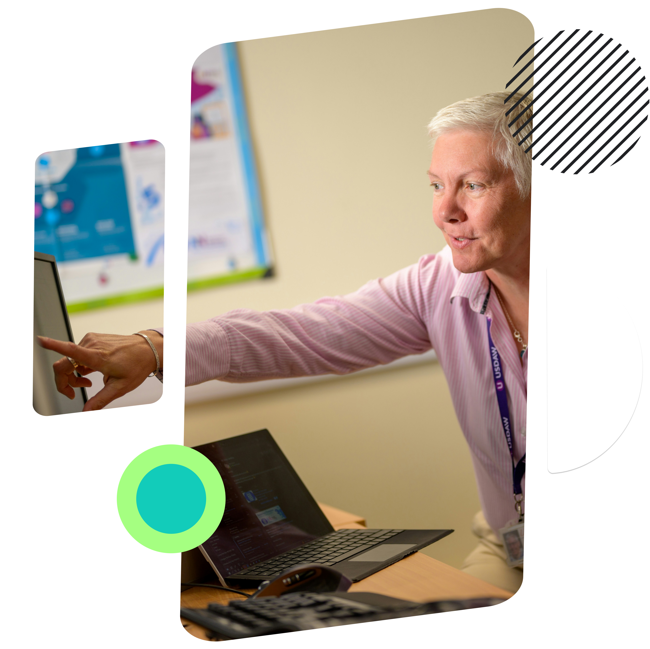

The connection between SEO and Accessibility: Writing for your audience
Write for your audience, not your coworker
Standardize a reading level (8th grade)
Avoid unnecessary jargon
Explain acronyms
Focus on clear structure
Notes:
Emily's slide
Using marketing language on the web, may not translate well
Web writer

Slide 10

You can explain even the most difficult subjects clearly
Break up content with lists and short sentences
Use domain-specific terms
Match complexity to page goals
Notes:
Emily's slide to talk about example of readability and clarity
Keep topic complexity, easier for users and search engines to scan
Talk about admissions vs research publication page
IU Halls of Residence to IU Housing

Slide 11



Accessibility helps with online topic authority
User-centric content
More context for algorithms
A better experience promotes sharing
Plain language improves user experience (and engagement metrics)
Intuitive navigation helps users and search engines find more of your content
Clear page titles improve click rates and support SEO relevance
Descriptive link text supports usability and keyword relevance
Accessible page structure helps Google & AI better understand the context of your content
More text-based alternatives including captions, descriptions and transcripts provide data that search engines can use
If you build pages with user experience at the forefront, it's easier for users to share your page as an authority
Links are still important for SEO, but brand citations are for AI Search
Positioning your brand as an authority will help with both
11
Notes:
Christina to start the slide.
Diane to pick up with third column

Slide 12

Changing the search game
Organization information can be accessed outside of the website in a chat interface with search engines
  Think: What is the tuition at [Siteimprove] University in 2025?
  How to pay water bill in [city]
Significant traffic drops
  Standing out as the authority on a topic matters in this new reality.
  Traffic won’t be the metric going forward – start including new metrics in your reporting
Notes:
Diane's slide
Traffic won't be the metric going forward
Don't measure your reputation/authority based on traffic

Slide 13
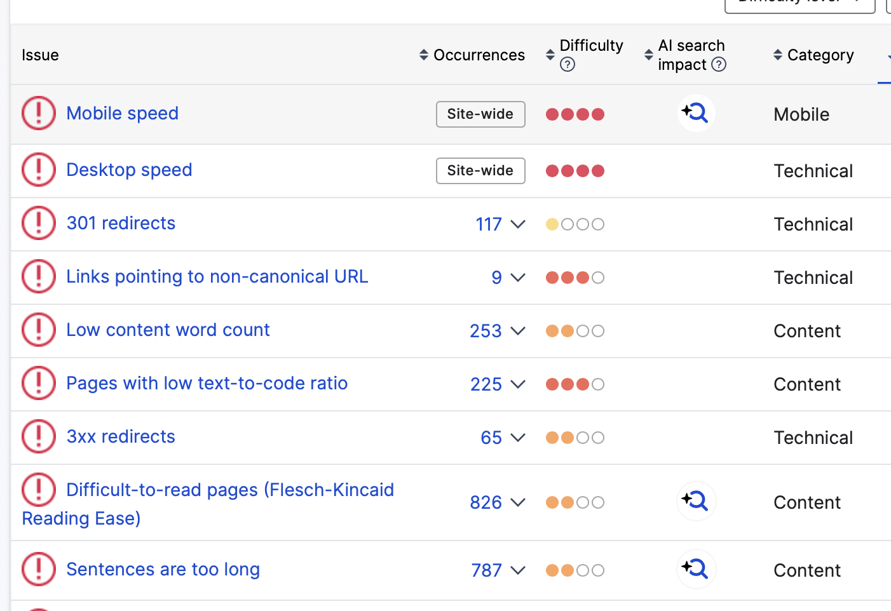
Making content easier to find
Check your topics in AI chats & search engines
  Looking for brand sites vs. aggregators
  Are AI Overviews showing up?
Determine your audience
  Address audience questions
  Are there terms your competitors are missing?
Bonus: Use Siteimprove’s AI Search Impact feature to assess key technical optimizations for AI Search
Notes:
Diane's slide
Note: Siteimprove’s capabilities with SERP X-Ray and Heatmap in the Keyword Intelligence Pro

Slide 14



How AI is empowering teams with SEO
Content Structure
Content
Clarity
Search Engine Compatibility
Ask AI to suggest ways to organize key points, separate sections, and add summaries.
Ask AI to review your content for clarity from the viewpoint of your target persona before conducting interviews.
Ask AI for a quick review of content pieces and single pages for SEO gaps before more thorough analysis.
Notes:
Emily to cover
Convert to panel question
Screenshot can be helpful
Key takeaways

Slide 15
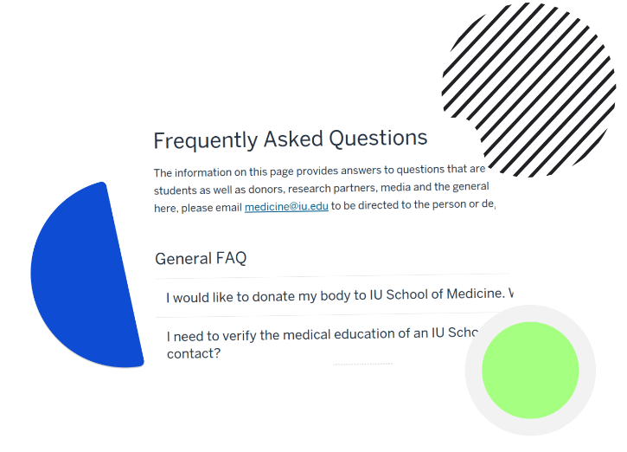
Prioritize most-used pages
Prioritize pages that have the highest traffic
Ensure that your conversion pages incorporate SEO and accessibility best practices
Optimize content that answers questions as this is a main entry point for users
Tap your experts to build FAQ sections that support understanding of complex topics
Notes:
Emily's slide: how to find pages to start with optimizing by looking at traffic or at user journeys including entry point pages
Step 1 – prioritize entry pages
AI and transition
Step 2 –meat and considerations
Make content more understandable – create different pages, with subsections of content
Can then feature more SMEs
Audiences are going to LLMs to ask long-form questions
Questions are still important, and long-form questions even more so in LLMs
Expertise will help with AI overviews
First-person knowledge including testimonials and fresh data

Slide 16
Audit your site structure and content
Consolidate domains to improve user navigation experience
Address content duplication across multiple domains
Add interlinking
Ensure regular site maintenance includes checks for accessibility, UX, and SEO
IU.edu
Bloomington
Indianapolis
Online
Business School
Business School
Course Application
Course Application
Course Description
Notes:
Emily's slide
Potential to talk about domain consolidation making site navigation easier and more intuitive
New guidelines for navigation
Thinking more about domain strategy and content strategy, aligned with consolidation efforts
Accessibility, user experience, and SEO
Site maintenance angle
1 – Work to consolidate domain
2 – Find places where we have dulicated content, only have to update in one place, only updated by one person, updated everywhere
Help avoid page cannibalization

Slide 17
POLL:
How are your teams currently collaborating to improve accessibility and SEO?
Notes:
Ilyssa to host poll
All teams who touch the website are working together
Some of our departments are collaborating, but not all together
We have a small, mighty team doing as much as possible in one department
This hasn't been a big priority to date

Slide 18









Create a bigger impact with cross-collaboration
Content Planning
UX/Design
Technical Requirements
Web Development
Quality Assurance
Testing
Launch
Accessibility
Requirements
Reusable
Components
Check All
Metadata
Verify Strong
UX
Clarity
Accessible
Design
Collect Feedback and Check Scores
Semantic
Structure
Open to
Crawling & AI
Check All
Metadata
Verify Strong
UX
Report on
Conversions
& Time on Page
Competitive
Gaps
Content
Tagging
Highlight common goals
Share results to make faster decisions
Notes:
Diane and Christina to cover
Can't just be reacting, need to be planning content, experience before it's created
When gathering requirements
Content, SEO and content governance work in a different silo than those working on accessibility
Work on both parties benefits each other as long as we're not duplicating work
Provide recommendation
Collaboration is so important,
Putting as much focus on organic traffic (10% of focus on paid traffic could )
Joining forces SEO + Accessibility to have a seat at the table

Slide 19
Key takeaways
1
Accessibility best practices directly enhance topic authority
2
To show authority, create original and educational content with your experts that is appropriate for your audience
3
Collaborate to plan your content so it is accessible to your audience from the start
4
AI is changing the search game - brand citations matter more than ever
Notes:
Ilyssa to cover

Slide 20

Live Q&A

Slide 21



Thank you for joining us today!
Defending Topic Authority with Web Accessibility
Learn more about Siteimprove's SEO Suite
Watch this webinar to learn how to find content gaps your competitors ignore.

