Slide 1



Annual Interagency Accessibility Forum
NONPUBLIC//FDIC BUSINESS
Achieving Digital Equity: Policies, Tools, and Techniques
November 13-14, 2024
That Doesn’t Need to be a PDF
Kathy Eng - USAB | Larry Gillick – FDIC | Michael Horton - GSA

Slide 2


Introductions
NONPUBLIC//FDIC BUSINESS
Kathy Eng
U.S. Access Board (USAB)
Larry Gillick
Federal Deposit Insurance Corporation (FDIC)
Michael Horton
General Services Administration (GSA)

Slide 3

Agenda
NONPUBLIC//FDIC BUSINESS
Why doesn’t that need to be a PDF?
Is there still a place for PDF?
But what about [insert reason]?
Is there a sample decision tree?
Do you have any real-world examples?

Slide 4

Why do we not like PDFs?
NONPUBLIC//FDIC BUSINESS
We’ve used a smartphone
Our bosses have used smartphones
Our customers use smartphones
They’re a pain to make accessible
  Accessibility: good
  Pain: bad

Slide 5

Why Doesn’t That Need to be a PDF?
NONPUBLIC//FDIC BUSINESS
Strengthening Digital Accessibility and the Management of Section 508 of the Rehabilitation Act (M-24-08)
Delivering a Digital-First Public Experience (M-23-22)
21st Century Integrated Digital Experience Act (21st Century IDEA)
Connected Government Act of 2018

Slide 6


Is there still a place for PDF?
NONPUBLIC//FDIC BUSINESS
Yes. They include:
Electronic stamps and signatures, but that depends
Congressionally mandated reports, see GPO guidelines
…

Slide 7
But what about [insert reason]?
NONPUBLIC//FDIC BUSINESS
Digital signature?
PDFs intended for printing?
Device portability?
Security of content?
That’s our process?
We don’t know any better?
Our bosses don’t know any better?
None of our customers use smartphones - and never will?
“Our users print stuff”?

Slide 8
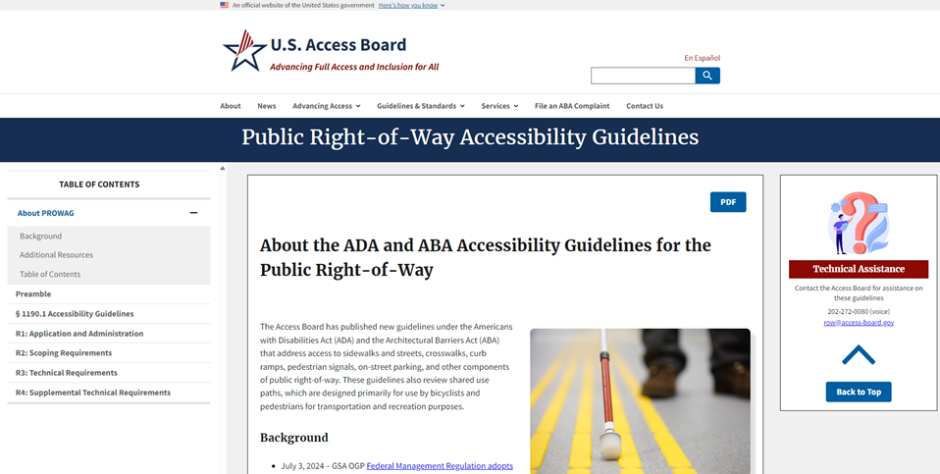
The Web Page
NONPUBLIC//FDIC BUSINESS

Slide 9
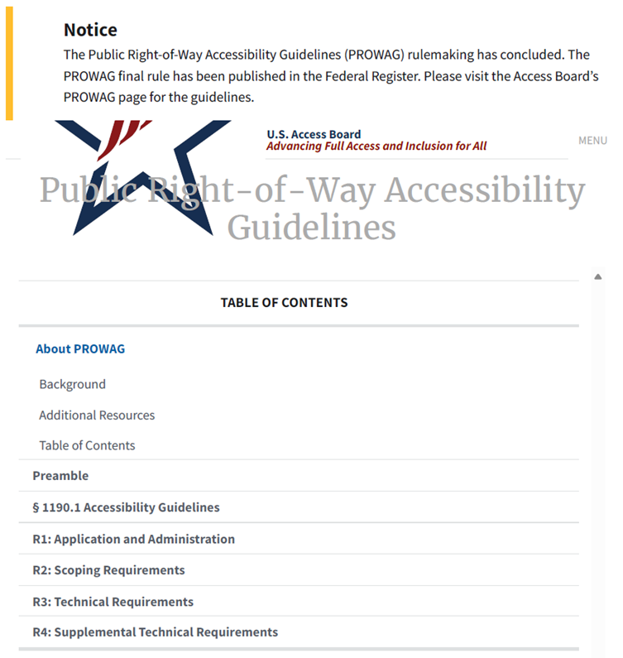
The Web Page Printed
NONPUBLIC//FDIC BUSINESS
Unnecessary website notice
Logo too big and heading poor contrast
Menu button and TOC nav that don’t work
No real info on page 1

Slide 10
The Web Page Doesn’t Print Nicely
NONPUBLIC//FDIC BUSINESS
Let’s create a PDF!
  Pros
    It can look how we want it to look
  Cons
    Every change to the content requires a new PDF file
    Creating accessible PDF takes a lot of time
It’s a web page - fix the CSS!
  All the Pros of PDF
  None of the Cons

Slide 11
Let’s Fix the CSS
NONPUBLIC//FDIC BUSINESS
Add/modify in style sheet:
    @media print { }
  Only applies styles to printed pages
  Ex:
    @media print {
    body {
    font-size: 12pt;
    color: black;
    }
    }

Slide 12
Don’t Print Clutter
NONPUBLIC//FDIC BUSINESS
.noprint {
display:none;}
Add class=“noprint” to anything you don’t want printed
Don’t print any:
footer, nav, .usa-skipnav, hr, button, #toc, .noprint

Slide 13
Adjust Print Appearance
NONPUBLIC//FDIC BUSINESS
Logo too big
.star-logo-box {
max-width:2rem; height:auto
}
Heading poor contrast
h1,h2,h3,h4,h5,h6 {
color:#000 !important;
background-color:#fff
}

Slide 14
More Print CSS
NONPUBLIC//FDIC BUSINESS
Show URLs for links
Add !important to ensure print styles are not overridden
Avoid page breaks in images, tables, links, headings
Avoid page breaks after headings
a::after {
content: " (" attr(href) ")" !important;
font-style: italic
}
table,figure,img,svg,a {
page-break-inside: avoid
}
h1,h2,h3,h4,h5,h6 {
page-break-after: avoid;
page-break-inside: avoid
}

Slide 15
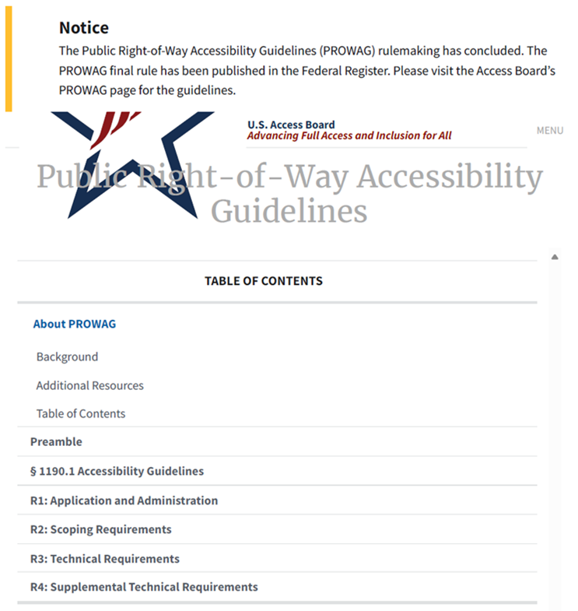
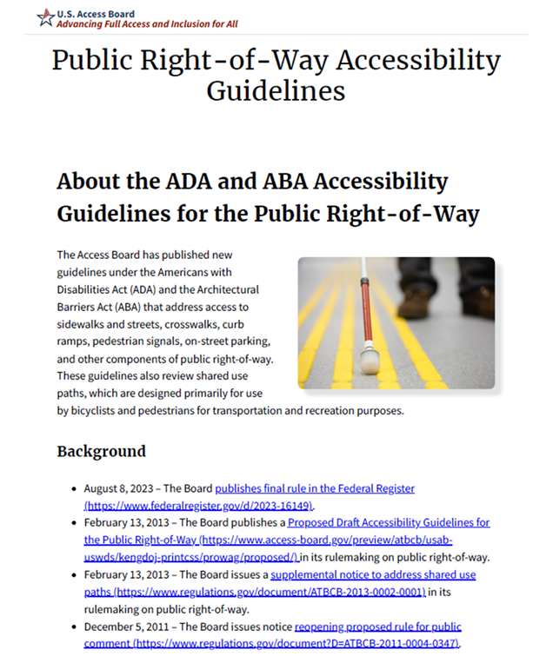
Much Better!
NONPUBLIC//FDIC BUSINESS
Page 1 Before
Page 1 After

Slide 16
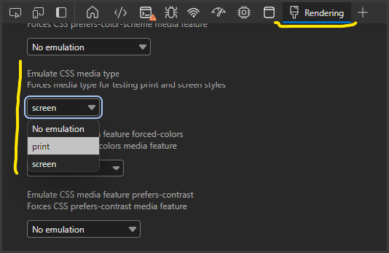
Print Preview Tip
NONPUBLIC//FDIC BUSINESS
Browser inspection tool
  Rendering – Emulate CSS media type:
    Select print
Browser renders page with print media CSS
  Faster than browser’s print preview

Slide 17
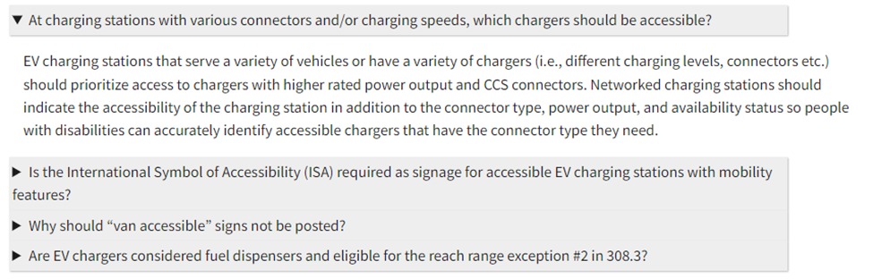
ARIA Accordions Not Ideal
NONPUBLIC//FDIC BUSINESS

Slide 18
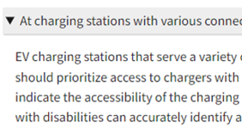
Use HTML <details> and <summary>
NONPUBLIC//FDIC BUSINESS
<details>
<summary>At charging stations with various connectors and/or charging speeds, which chargers should be accessible?</summary>
<p>EV charging stations that serve a variety … that have the connector type they need.</p>
</details>

Slide 19
Use CSS to Style
NONPUBLIC//FDIC BUSINESS
(not within @media print { } )
details>summary {
padding: 4px;
width: 90%;
background-color: #eeeeee;
border: none;
box-shadow: 1px 1px 2px #bbbbbb;
cursor: pointer
}
details>p {
padding: 4px;
margin: 12px
}

Slide 20
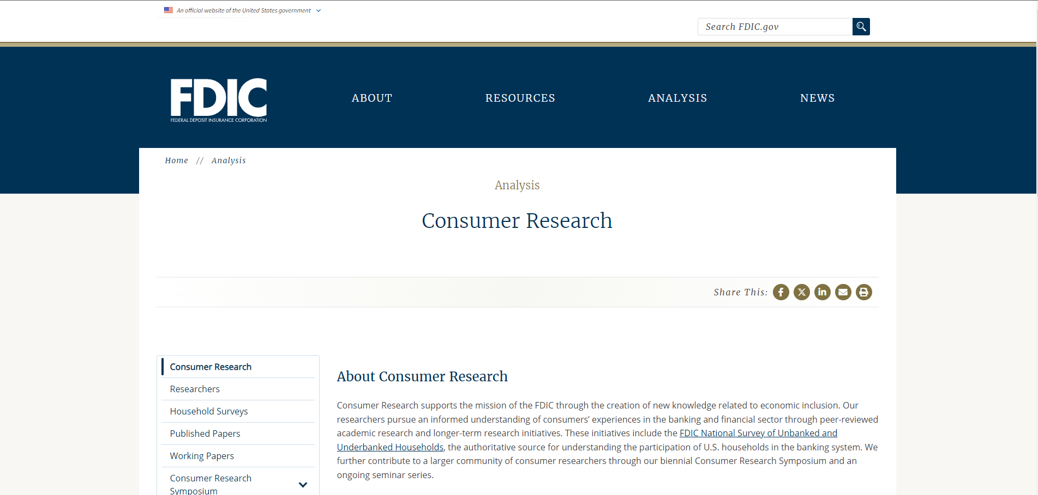
Plenty of Content Can be Styled Away for Printing - Example 1 Before
NONPUBLIC//FDIC BUSINESS

Slide 21
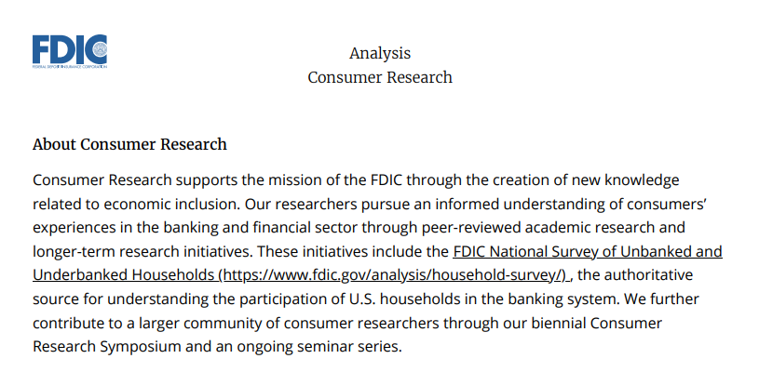
Plenty of Content Can be Styled Away for Printing - Example 1 After
NONPUBLIC//FDIC BUSINESS

Slide 22
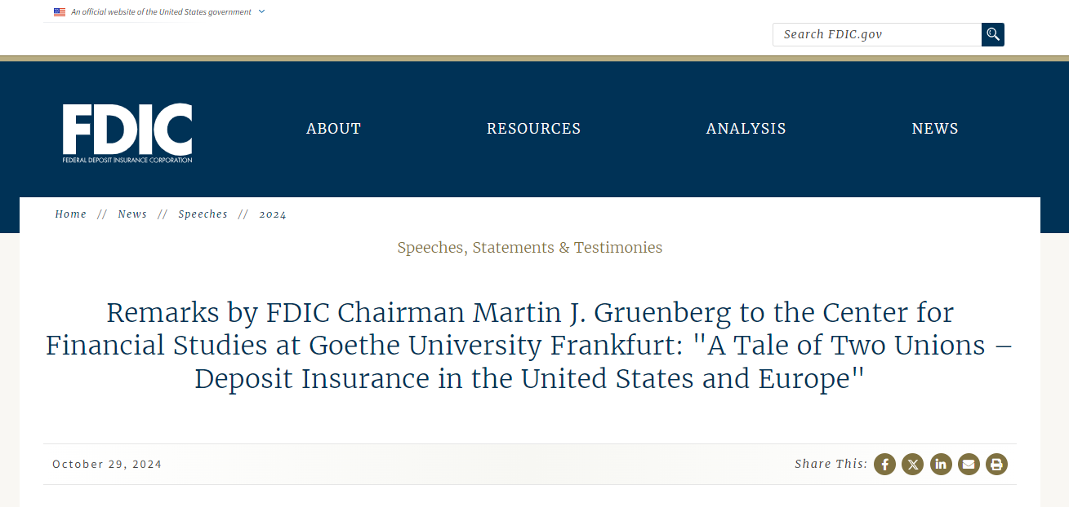
Plenty of Content Can be Styled Away for Printing - Example 2 Before
NONPUBLIC//FDIC BUSINESS

Slide 23
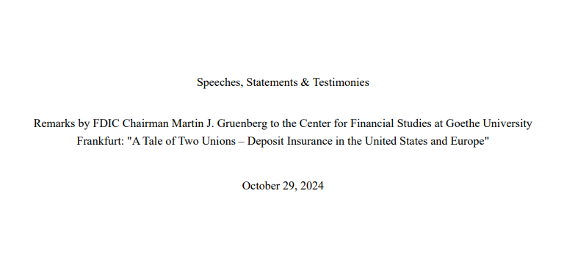
Plenty of Content Can be Styled Away for Printing - Example 2 After
NONPUBLIC//FDIC BUSINESS

Slide 24
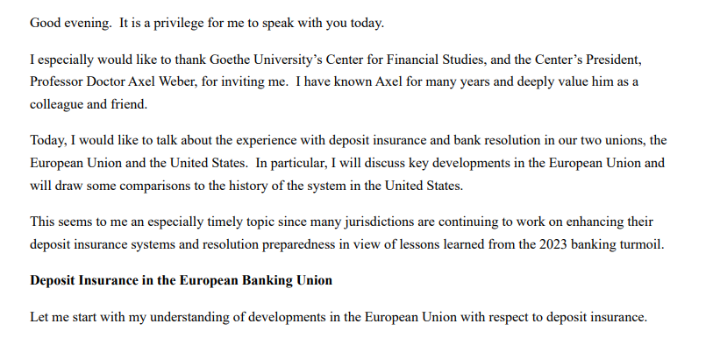
Plenty of Content Can be Styled Away for Printing - Example 2 After (Continued)
NONPUBLIC//FDIC BUSINESS

Slide 25
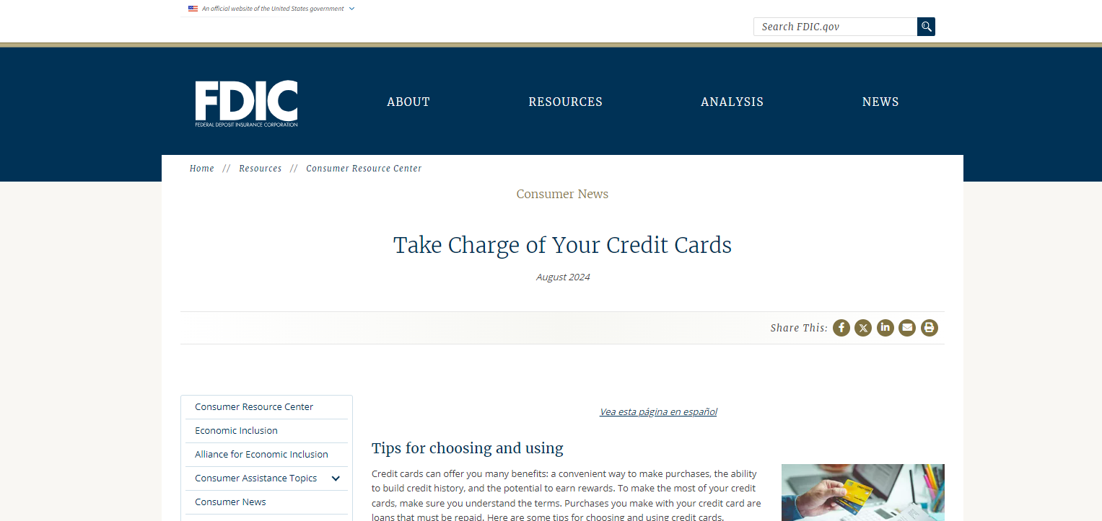
Plenty of Content Can be Styled Away for Printing - Example 3 Before
NONPUBLIC//FDIC BUSINESS

Slide 26
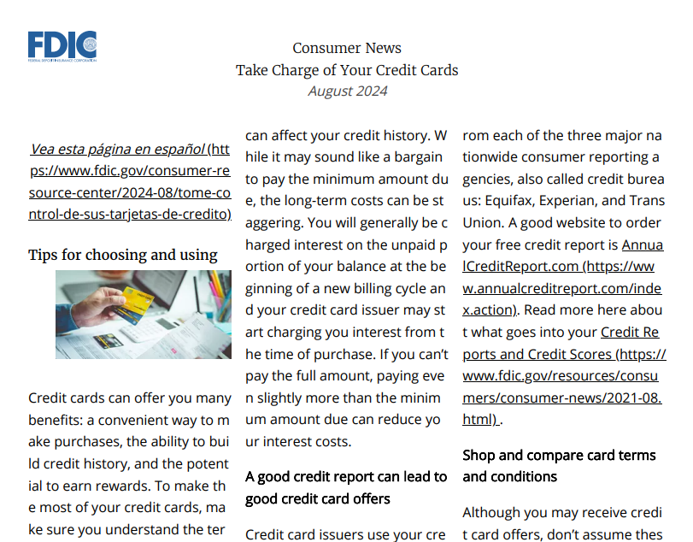
Plenty of Content Can be Styled Away for Printing - Example 3 After
NONPUBLIC//FDIC BUSINESS

Slide 27
Is There a Sample Decision Tree?
NONPUBLIC//FDIC BUSINESS
Is the content primarily text-based and simple in structure?
  Yes → HTML is ideal for text-heavy content that’s meant to be read on the web. It’s easily accessible, adaptable to different screen sizes, and more SEO-friendly.
  No → PDF may be ideal for longer documents. Go to the next question.
Does the content require a fixed layout or complex formatting (e.g., graphics, tables, forms, specific fonts)?
  Yes → Either format could be suitable depending on other factors. PDF is best for content where the visual layout is important, such as forms*, reports, brochures, and print-ready documents. It preserves the original formatting across devices. (*Forms alone should not result in a PDF file. Perhaps PDF is an alternate version?)
  No → Go to the next question.
Is the document intended for printing or offline use?
  Yes → PDF may be better for documents that will likely be printed, such as brochures, and print-ready documents, or shared offline, as it maintains its structure and format regardless of the device. This exclude information online a print-friendly (minus navigation, only content) version is desired for audience.
  No → Go to the next question.

Slide 28
Is There a Sample Decision Tree? (Continued)
NONPUBLIC//FDIC BUSINESS
Is the content meant to be easily searchable, editable, or updated frequently?
  Yes → HTML is preferable for content that needs to be interactive, dynamic, frequently updated, version controlled or indexed by search engines.
  No → Go to the next question.
Is accessibility for all users (screen readers, mobile devices, etc.) a key priority?
  Yes! → HTML is generally more accessible than document formats such as PDF, Word and PowerPoint, as it can be made responsive (mobile-friendly) and is easier to adapt to assistive technologies. While PDFs can also be made accessible, they require more effort.
  No → Either format could be suitable depending on other factors.
Does the content need to be easily shareable or distributed via download?
  Yes → Either format could be suitable depending on other factors. PDF have been the ideal format or sharing and distribution, as they can be downloaded and viewed offline, maintaining their format. So can HTML.
  No → HTML is better suited for content that will remain online and doesn’t need to be downloaded.

Slide 29
References
NONPUBLIC//FDIC BUSINESS
You may notice that some of our references are a tad dated, even “old.” None of this is new. It’s just under-used.
I’ve been using “print” css for decades, but I’d be fibbing if I said I didn’t check references before sharing – or that I haven’t been inspired by the works of others. Here are my sources for this document, with a hat-tip to the authors, who deserve each footnote:
Designing For Print With CSS, Rachel Andrew, Smashing Magazine, 2015/01/07
A brief history of CSS until 2016, Bert Bos, W3C, 2016/12/17
6 Things I Learned About Print Stylesheets From HTML5 Boilerplate, Joshua Johnson, Design Shack, 2011/11/15
How to set up a print style sheet, Christian Krammer, Smashing Magazine, 2011/11/24
Print Different, Eric Meyer, Meyerweb, 2000/01
Media Queries Level 3, W3C Recommendation, 2022/04/05

Slide 30
Other Resources
NONPUBLIC//FDIC BUSINESS
PDFs: A Digital Content Detour | Digital.gov
Why GOV.UK content should be published in HTML and not PDF
PDF: Still Unfit for Human Consumption, 20 Years Later
Create Electronic Signatures | Section508.gov

Slide 31

Questions?
NONPUBLIC//FDIC BUSINESS

